Slide 1
Public Transportation (Tribal Transit) Planning
David Kack
Executive Director, WTI
Director, Small Urban, Rural and Tribal Center on Mobility (SURTCOM)

Slide 2
Tribal Lands Recognition
Louisville area home to:
Kaskaskia
Myaamia
Osage
Shawandasse Tula (Shawanwaki/Shawnee)
The Adena and Hopewell Cultures, and likely many other indigenous people who passed through this area

Slide 3
SURTCOM Small Urban, Rural and Tribal Center on Mobility A fierce combination of Bobcats, Bison & Eagles

Slide 4
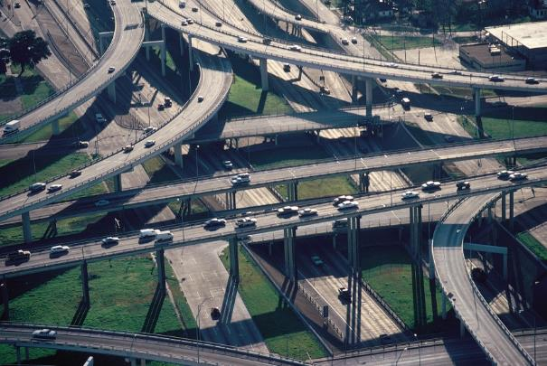
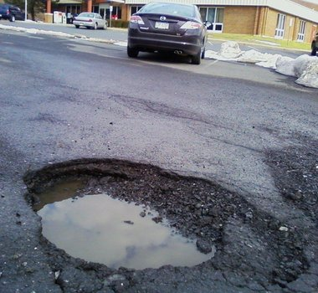
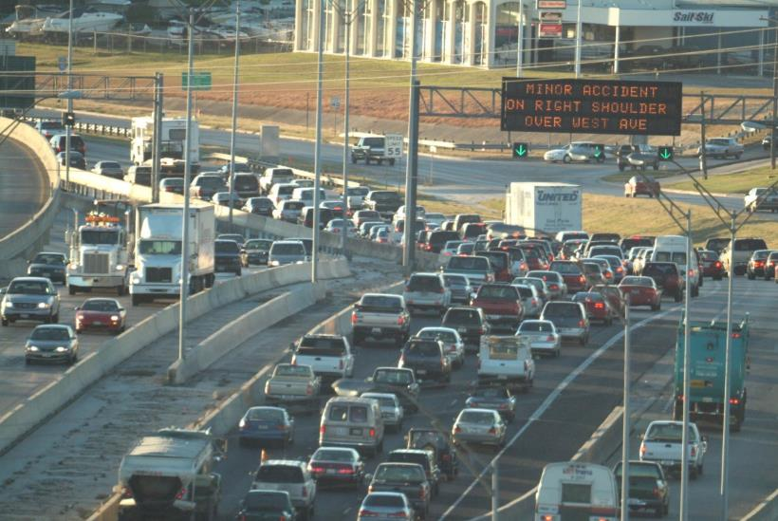
“Transportation”

Slide 5
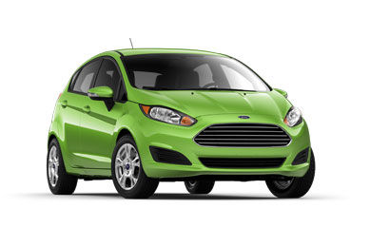
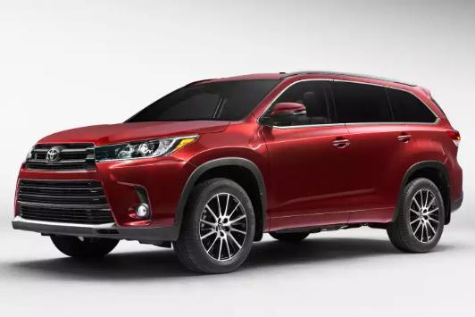
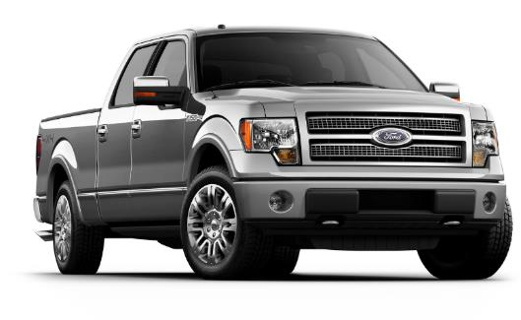
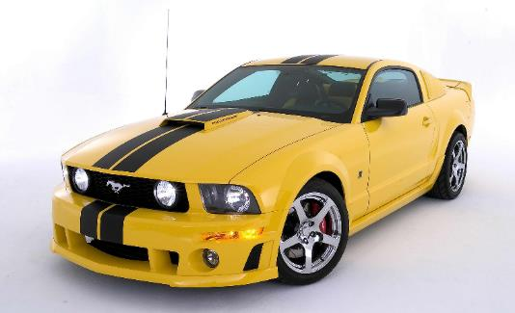
“Mobility”

Slide 6
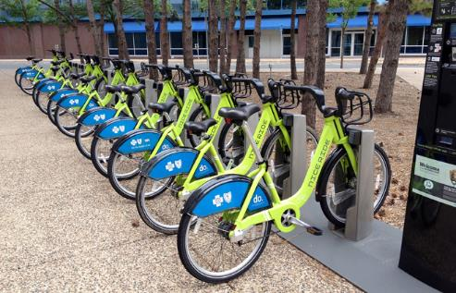
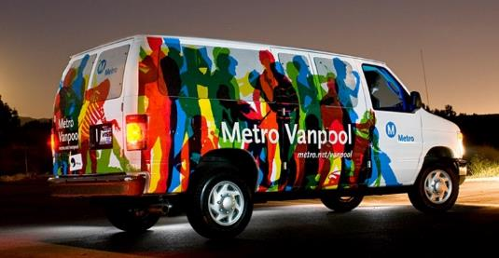
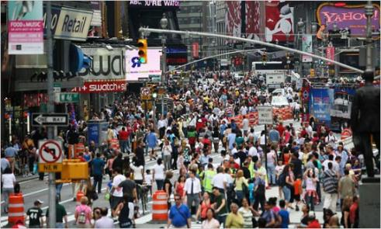
Mobility

Slide 7
Mobility: A Means To An End

Slide 8
Cost of Mobility
Source: 2020 Consumer Expenditures. Bureau of Labor Statistics, U.S. Department of Labor
Note: In 1917 transportation was 2% of the budget, or the 6th highest expense

Slide 9
Cost of Mobility Annual Cost to Own & Operate a Car
Annual Mileage | Small Sedan | Medium Sedan | Subcompact SUV | Compact SUV | Medium SUV | Avg.
10,000 | $6,029 | $7,895 | $6,827 | $6,675 | $7,992 | $7,084
15,000 | $8,184 | $10,351 | $9,246 | $9,325 | $11,305 | $9,682
20,000 | $10,427 | $12,908 | $11,755 | $12,096 | $14,763 | $12,390
Note: Based on 250 working days,
10,000 miles equals 40 miles per day
15,000 miles equals 50 miles per day
Source: AAA Your Driving Costs 2022 Edition

Slide 10
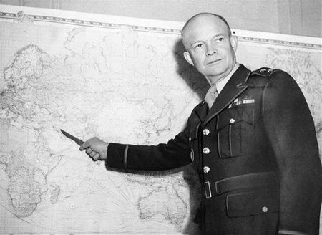
“Plans are worthless, but planning is everything”
--President/General Eisenhower

Slide 11
Where to Start?
“Do what you can, with what you have, where you are.”
-Theodore Roosevelt
“A journey of a thousand miles begins with a single step”
-Lao Tzu

Slide 12
Questions to Ask
What would “success” look like?
How does public transportation fit into your Transportation Master Plan?
How multimodal do you want your community to be?
What are you doing to make your community more inviting to other modes (beyond the car)?
What mobility ecosystem does your community want to invest in?

Slide 13
Mobility Service Options & Tradeoffs
Fixed Route
Microtransit
Demand Response
Van Pool
Volunteer Driver Programs
TNCs, Taxis, Other
Bicycling and walking!

Slide 14
Tribal Transit Formula Grants - 5311(c)(1)(B)
Eligible Activities:
Provides funding to federally recognized Indian tribes to provide public transportation services on and around Indian reservations or tribal land in rural areas. Federally recognized tribes may use the funding for capital, operating, planning, and administrative expenses for public transit projects that meet the growing needs of rural tribal communities. Examples of eligible activities include: capital projects; operating costs of equipment and facilities for use in public transportation; and the acquisition of public transportation services, including service agreements with private providers of public transportation services.

Slide 15
Tribal Transit Formula Grants - 5311(c)(1)(B)
Allocation of Funding:
In order to received formula funds a tribe must report to the National Transit Database (NTD) on an annual basis. FTA apportions Tribal Transit funds to Indian tribes by a statutory formula using the NTD and the latest available American Community Survey (Census Bureau) data.
The three tiers under the formula include:
Tier 1: 50 percent of the available funds are apportioned based on vehicle revenue miles;
Tier 2: 25 percent of the available funds are apportioned among Indian tribes providing at least two hundred thousand annual vehicle revenue miles; and
Tier 3: 25 percent of the available funds are apportioned among Indian tribes providing public transportation on tribal lands where more than one thousand low-income persons reside.

Slide 16
Other Funding Opportunities
Tribal Transit Competitive Program, 49 U.S.C. § 5311(c)(1)(A)
Rural Areas Formula Program, 49 U.S.C. § 5311
Enhanced Mobility of Seniors and Individuals with Disabilities Formula Program, 49 U.S.C. § 5310
State Funding?

Slide 17
Planning Process – One Example

Slide 18
Set Goals
Why are you planning?
What do you want to change?
Who is involved in setting the goals?
Are the goals compatible with other plans that have been made?
Are your goals SMART?

Slide 19
SMART Goals

Slide 20
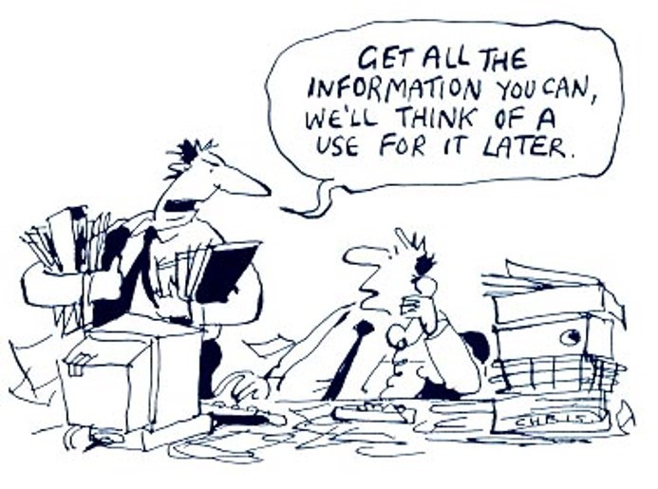
Gather Data
What metrics are you using for your plan?
What will you measure to determine if you are making a difference?
Will you be able to gather the data on an on-going basis in a reasonably easy manner?

Slide 21
Analyze Data
There are lies, damn lies, and statistics
--Mark Twain
Do we have good data?
What are the “trends” we see over time?
Do we have consistency with the data?
Are there outliers?
What statistics are we using?
Are we trying to make the data fit what we think it should look like?

Slide 22
Create (Action)Plan
How are you going to achieve/implement that which you are planning to do?

Slide 23
Implement the Plan
Do what you planned to do!
This is when the “rubber meets the road”!

Slide 24
Monitor the Plan…
..and evaluate the results.
Are things going the way you expected them to?
What have you learned since implementation?

Slide 25
Start The Process Again!

Slide 26
Technical/Planning Assistance
Community Transportation Association of America (CTAA
National Rural Transportation Assistance Program (NRTAP)
National Center on Mobility Management (NCMM)
National Aging and Disability Transportation Center (NADTC)
National Center for Applied Transit Technology (N-CATT)
State Transit Associations
Tribal Transportation Assistance Programs (TTAPs)
University Transportation Centers (UTCs)

Slide 27
One of many resources to help you in your planning process
This Guidebook is currently being updated by a group led by the KFH Group, and includes WTI/MSU, NDSU and EWU

Slide 28
Just Do It!!
In any moment of decision, the best thing you can do is the right thing, the next best thing is the wrong thing, and the worst thing you can do is nothing.
--Theodore Roosevelt
I have been impressed with the urgency of doing.
Knowing is not enough; we must apply.
Being willing is not enough; we must do.
--Leonardo Da Vinci

Slide 29
A Different View?
“It's tough to make predictions, especially about the future.”
― Yogi Berra

Slide 30
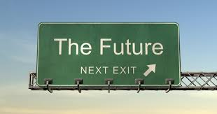
Questions - Discussion
“The future depends upon what we do in the present”
--Mahatma Gandhi

