Slide 1
“Turning Piles of Rocks into Piles of Money” National Transportation in Indian Country Conference Louisville, Kentucky August 25, 2022
Dennis Bodenchuk –
Deputy Division Chief (Acting) & Branch Chief, Solid Minerals

Slide 2
Dennis Bodenchuk Roman/Slavic
Deputy Division Chief (Acting)
Branch Chief – Solid Minerals
Dennis Bodenchuk is the Solid Minerals Branch Chief at DEMD. He holds Bachelors and Masters degrees in Geology. He is a certified Petroleum Geologist with over 40 years of work experience. He has worked at DEMD in varying capacities (Division Chief, Branch Chief) and has served as the Branch Chief for both the Fluids and Solid Minerals Branches. He has worked previously with a variety of O & G companies and as an Independent Geologist. Dennis continues to work with DEMD and assists Tribes all over the United States of America. He has also assisted indigenous peoples with resource development in Africa and South America.

Slide 3
Agenda
DEMD Overview
Solid Mineral Branch Presentation
Aggregate Basics
Tribal Competitive Advantage
Income Generation
Cost Savings
Benefits of Owning a Tribal Business
Examples

Slide 7
Notes:
Technical assistance and various services, especially Business Services

Slide 8
Solid Minerals Branch staff assists Tribes and allottees in assessing and developing their solid mineral resources, evaluating economic viability of development, and bringing resources into production and profitable businesses. The result is improved infrastructure, jobs, and increased sustainable tribal revenues.
Commodities Served:
Base and Precious Metals: e.g., gold, silver, copper…
Industrial Minerals: e.g., limestone, gypsum, clay, building stone…
Aggregates: e.g., sand & gravel, crushed stone
Critical Minerals: e.g., rare earth elements, lithium, manganese, tungsten…
Coal & Uranium

Slide 9
$6.5MM
Energy and Mineral Development Grant Program (EMDP)
Awarded
FY 2020
Annual grant
Purpose: to technically assess tribal energy and mineral resources
Produce documents Tribes can take to the bank
No Cost Match
82
$45.1MM
Requested
FY 2022
Proposals Received
FY 2022

Slide 10
DEMD’s Approach to Tribal Technical Assistance
Employs across-the-board utilization of DEMD staff’s multiple skill sets.
This technical assistance is hands on and proactive. It incorporates the full spectrum of services required to change resources into viable economic engines
Assessment of a resource's quality and quantity
Feasibility Studies- equipment needs, Capex/Opex calculations, financial analysis, business structure
Marketing- local/regional sales forecasts, market forecasting, existing and future competition, branding assistance
Financial- Financial statement creation and analysis, short/long term income streams, potential lenders, government grants, other potential sources of capital
Loans-BIA/DOE/USDA/SBA Loan Guarantees, working with local/regional/national lending institutions
Land Management-consolidation of Tribal lands, identification of desirable land acquisitions, for ultimate “fee to trust”
Notes:
This technical assistance is so much more than just determining quality and quantity of a resource.

Slide 11
Notes:
Maine to California, Florida to Alaska

Slide 12
Question?
Which mineable commodity generates the most money in sales in the United States?

Slide 13
Aggregate!
Sand
Gravel
Crushed Rock
Notes:
The estimated annual output of American construction aggregates produced for consumption
(pre-pandemic) 2019 total sales were about $26 Billion for aggregate and $28 Billion for all metals combined!

Slide 14
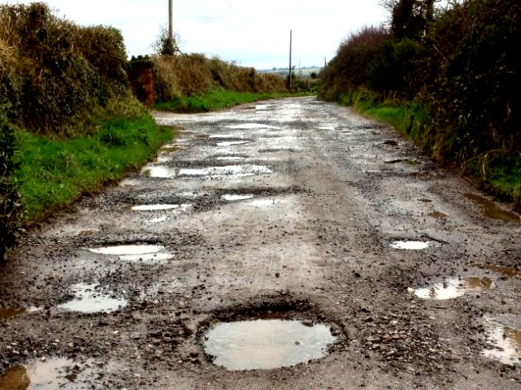
How does aggregate present an opportunity?
Aggregate is used for everything!
Construction and maintenance of roads and bridges
Emergency preparedness
Construction projects
Railroad ballast
Landscaping

Slide 15
Why Should a Tribe Develop its Aggregate Resources? Safe Roads Emergency Preparedness Inherent Economic Advantages Job Creation Income Generation Economic Diversity

Slide 16
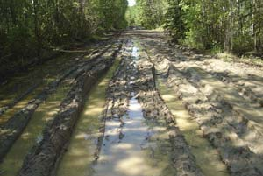
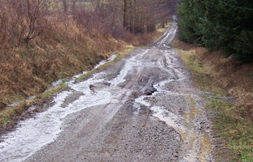
Road Construction and Maintenance
According to the Bureau of Indian Affairs, 83% of Tribal roads are classified as “not acceptable.”
80% of reservation roads are unpaved gravel roads.
Maintenance of the existing roads is vital.
New road construction provides a safe and reliable mode of travel.
Native Americans have the highest per capita number of road deaths of any demographic group in the USA.

Slide 17
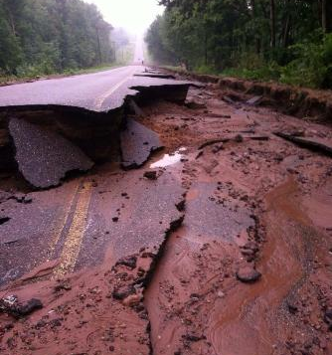
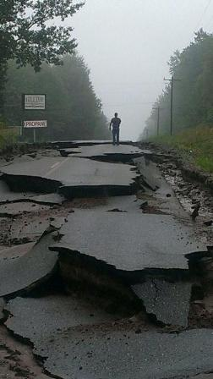
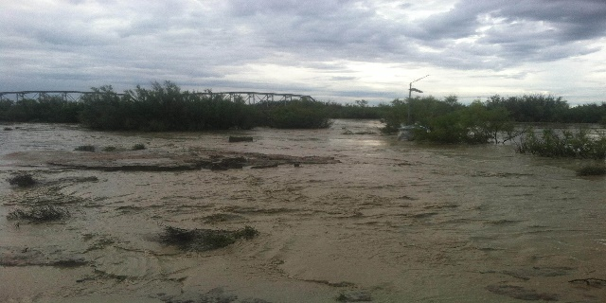
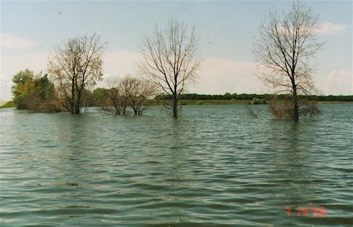
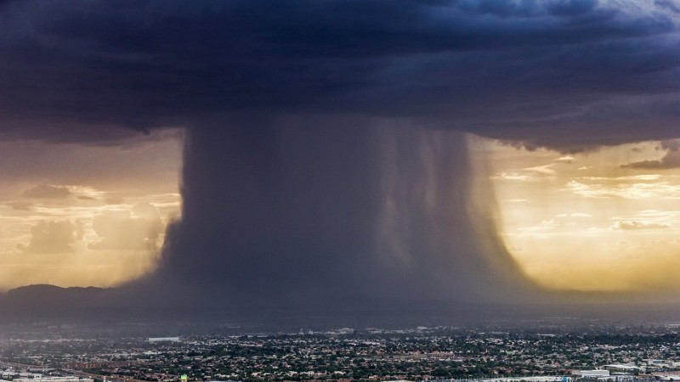
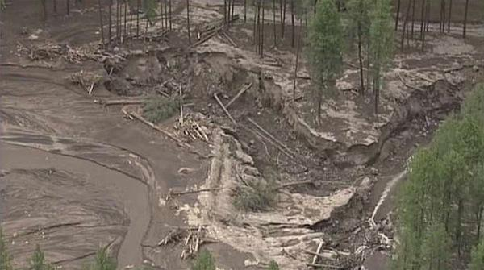
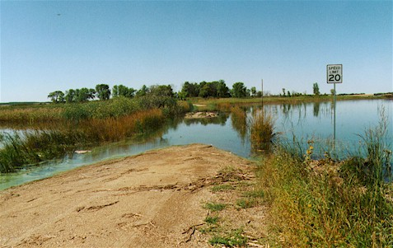
Emergency Preparedness
Emergency Preparedness
Development of a resource before a disaster occurs.
Readily available resources during a disaster.
Access to resources after the disaster.
Development of a resource before a disaster occurs.
Availability of a resource during a disaster.
Access to the resource after the disaster.
Cochiti Pueblo Flooding 2011
Spirit Lake Flooding
Santa Clara Pueblo Flooding 2013
When FEMA arrives, that typically means a disaster has already happened!
Notes:
We worked extensively with Cochiti and Spirit Lake. They had aggregate resources readily available and were able to use that to repair damages

Slide 18
Summary
"Good quality roads lead to safe and reliable transportation which is a cornerstone to successful commerce. Children need to get to school, employees need to get to work, and goods need to get to markets."

Slide 19
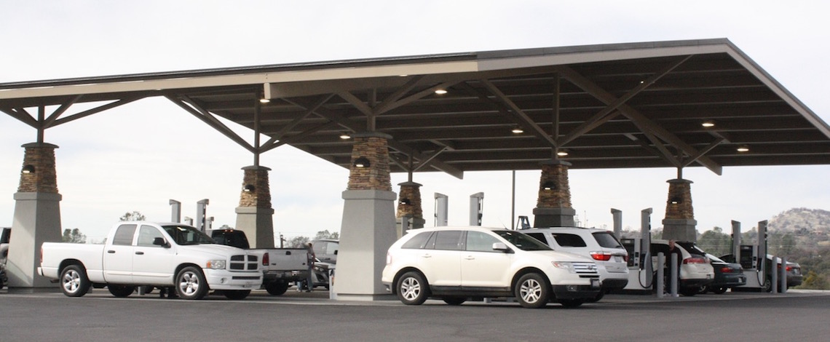
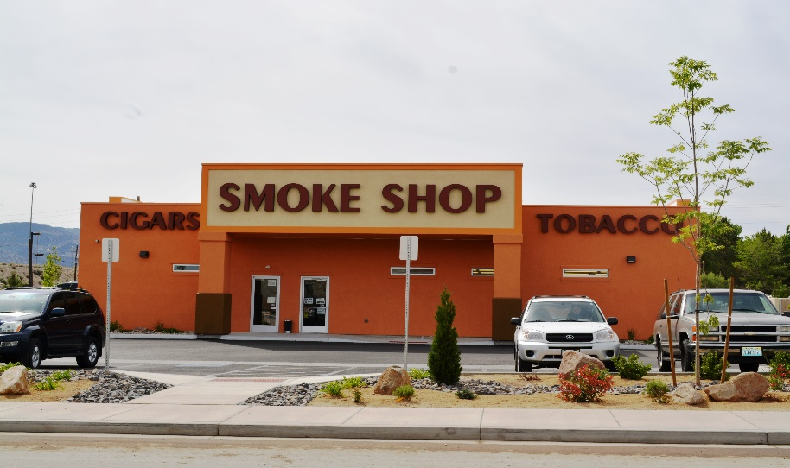
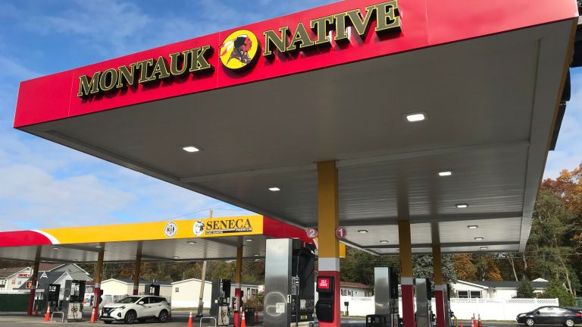
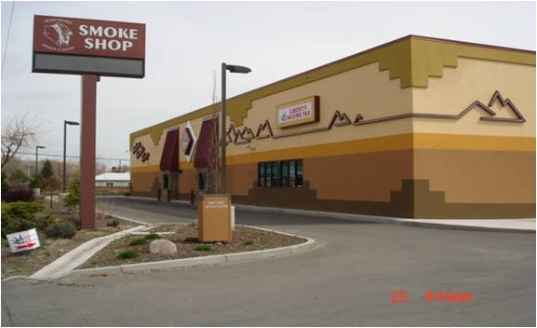
Aggregate: Why isn’t it marketed like gasoline or tobacco?

Slide 20
Aggregate: Why isn’t it marketed like gas or tobacco?
There is no good reason. It absolutely should.
Aggregate production shares the one economic parameter that allows Tribes to corner the market on gas and tobacco.
That shared economic parameter is the inherent tax advantages of Tribes compared to non-Indian owned businesses.

Slide 21
Inherent Economic Advantage
By using all its inherent economic advantages, a Tribe is poised to be a serious competitor in the aggregate market. Some of these advantages are:
Inherent Tax Structure benefits
Ability to establish Enterprise Zones
Qualifying for Disadvantaged Business status
Disadvantaged Business Enterprise (DBE) program –Department of Transportation
Small Disadvantaged Business (SDB) program
Equivalent state programs

Slide 22
SPECIFIC STATE EXAMPLES: California
Competitive Sand and Gravel Operation - Price Analysis – California (City Specific) 100,000 Ton per Year
 | Used | Used
 | Equipment | Equipment
 | Lease | Purchase
Scenario Assumptions: 100,000 tons annual production; 8.0% profit in each scenario | 5-Year Term | 7 Year Loan
Scenario | $/T | $/T
Case 1: Tribe Hires Contract Miner | $8.97 | $10.31
 | 8.0 % * | 8.0 % *
Case 2: 100% Tribally Owned and Operated | $8.05 | $9.40
 | 8.0 % * | 8.0 % *
Case 3: 100% Company Owned and Operated | $11.71 | $13.54
 | 8.0 % * | 8.0 % *
Profit Margin: Case 3 Minus Case 1 Tribe Hires Contract Miner | $2.74 | $3.23
Profit Margin: Case 3 Minus Case 2 Tribally Owned and Operated | $3.66 | $4.14
* Profit/Total Cost= 8%
California Taxes:
1. INCOME TAX- 8.84% | -
2. SALES AND USE TAX: STATE TAX 7.5%
3. PROPERTY TAX CALCULATION - PRESENT VALUE OF OPERATION TIMES 1.06%
4. SALES TAX ON MINING EQUIPMENT
5. CITY TAX 7.3%

Slide 23
SPECIFIC STATE EXAMPLES: Washington
Competitive Sand and Gravel Operation - Price Analysis – Washington State 100,000 Ton per Year
 | Used | Used
 | Equipment | Equipment
 | Lease | Purchase
Scenario Assumptions: 100,000 tons annual production; 8.0% profit in each scenario | 5-Year Term | 7 Year Loan
Scenario | $/T | $/T
Case 1: Tribe Hires Contract Miner | $8.97 | $10.31
 | 8.0 % * | 8.0 % *
Case 2: 100% Tribally Owned and Operated | $8.05 | $9.40
 | 8.0 % * | 8.0 % *
Case 3: 100% Company Owned and Operated | $11.45 | $13.15
 | 8.0 % * | 8.0 % *
Profit Margin: Case 3 Minus Case 1: Tribe Hires Contract Miner | $2.48 | $2.83
Profit Margin: Case 3 Minus Case 2: Tribally Owned and Operated | $3.40 | $3.75
* Company Owned - Profit/Total Cost
Washington Taxes:
1. NO INCOME TAX
2. SALES AND USE TAX: STATE TAX 6.5% LOCAL 8.7%
3. PROPERTY TAX CALCULATION - PRESENT VALUE OF OPERATION TIMES $11.45/$1,000
4. BUSINESS AND OCCUPATION TAX - $4.48/$1,000 TIMES GROSS SALES
5. NO SALES TAX ON MINING EQUIPMENT

Slide 24
Competitive Sand and Gravel Operation - Price Analysis - Minnesota
 | Used | Used
 | Equipment | Equipment
 | Lease | Purchase
 | 5-Year Term | 7 Year Loan
Scenario Assumptions: 100,000 tons annual production; 8.0% profit in each scenario | Dollars/Ton | Dollars/Ton
Case 1: Tribe Hires Contract Miner | $8.97 | $10.31
Case 2: 100% Tribally Owned and Operated | $8.05 | $9.40
Case 3: 100% Company Owned and Operated | $9.97 | $11.45
Profit Margin: Case 3 minus Case 1: Tribe Hires Contract Miner | $1.00 | $1.14
Profit Margin: Case 3 minus Case 2: Tribally Owned and Operated | $1.92 | $2.05
Case 3 Minnesota Taxes
Income Sales Property (Assessed Value)
Notes:
MODEL - Economic Benefits for the State of Minnesota as an example. TAXES ARE THE KEY HERE!
Note: The most basic case (Case 0) is a simple lease with a 10% royalty
The key is that a Tribe has a significant economic advantage over non-tribal operations, because of the tax advantages that Tribes have. Approximately $1/ton if a contract miner is used. Approximately $2/ton if tribally operated. That is extremely significant. More than a 10% difference in price (contract miner) and more than 20% (100% tribal operation).
The difference between the contract miner and Tribally owned and operated business is simply a 15% fee above costs for the contract miner. All taxes are the same.

Slide 25
Tribal Aggregate Operation: Benefits
Margin: Case 3: 100% Company Owned minus Case 1: Tribe Hires Contract Miner | Lease | Purchase
Michigan | $0.80 | $0.93
Wisconsin | $0.88 | $1.02
Minnesota | $1.00 | $1.14
Iowa | $1.01 | $1.15
Average | $0.92 | $1.06
Margin: Case 3: 100% Company Owned minus Case 2: 100% Tribally Owned | Lease | Purchase
Michigan | $1.72 | $1.84
Wisconsin | $1.80 | $1.93
Minnesota | $1.92 | $2.05
Iowa | $1.93 | $2.06
Average | $1.84 | $1.97
Notes:
Benefits to Tribe by State for a 100,000 tpy sand and gravel operation in which used capital equipment is leased or purchased.
So, all things being equal, everyone would be buying aggregate from Indians because those customers would be saving somewhere between 10% to 20%. It’s similar to gasoline sales and tobacco sales.
Note: Switching from Used to New capital equipment purchase would increase costs by about 30%.

Slide 26
Income generation (continued)
Individual income: Based on the following factors:
State of California operation, production at 50,000 tons/yr., 100% tribally owned.
4 direct jobs and 6 indirect jobs will be created (10 total ): refer to the economic multiplier
Foreman: $65,000/yr.
Front End Loader: $43,680/ yr. ($21/hr.)
Laborer: $37,440/yr. ($18/hr.) X 2= $74,880
Total: $183,560 (wages for 4 people/yr.)
PLUS
6 additional minimum wage jobs: ($15/hr. in CA in 2022 = $31,200/yr.) = ($187,220/6 jobs/yr.)
A GRAND TOTAL of $370,780 could be generated in and around the general vicinity of the aggregate operation that employs 4 people.

Slide 27
Income Generation (continued)
Individual income: Based on the following factors:
State of Minnesota operation, production at 50,000 tons/yr., 100% tribally owned.
4 direct jobs and 6 indirect jobs will be created (10 total ): 1.5 economic multiplier
Foreman: $60,000/yr.
Front End Loader: $43,680/ yr. ($21/hr.)
Laborer: $31,200/yr. ($11.50/hr.) X 2= $47,840
Total: $151,520 (wages for 4 people/yr.)
PLUS
6 additional minimum wage jobs: ($8.42/hr. in MN in 2022 = $17,514/yr.) = ($105,084/6 jobs/yr.)
A GRAND TOTAL of $256,604 could be generated in and around the general vicinity of the aggregate operation that employs 4 people.
And Aggregate operations tend to be “long lived.”

Slide 28
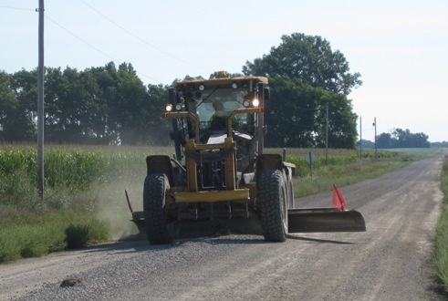
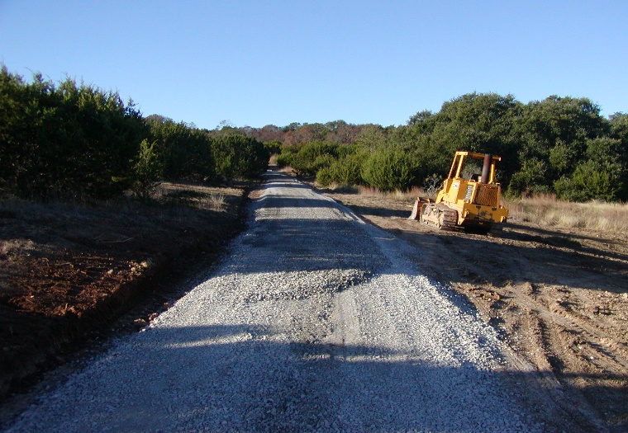
Cost Savings
Most construction projects on or near reservations rely on supplies of aggregate resources from non-Indian, off Reservation sources. This can be costly.
This is because aggregate is expensive to transport. About $9.00/ton to transport 30 miles by truck.
Remote reservations have paid up to THREE times as much for materials than consumers in metropolitan areas due to the high cost of transportation.
Solution: A tribe can develop its own aggregate resources, save money, maintain more roads and stretch its road budget.

Slide 29
Aggregates: Benefits of Owning and
Operating the Business
Tribal Sovereignty in Action
Tribal Independence
Control over production of tribal resources
operations, managing costs, higher revenues, more jobs (tribal hiring preference)
no lease burdens
tailor future development plans to Tribe’s needs, not developer’s needs
Additional income supports additional economic development
economic engine, integrating strategic development projects
secondary markets
Notes:
Tribal Independence = Tribe is now in the driver’s seat in terms of aggregate supply; stretches roads budget
Control over destiny=
Higher revenues and more tribal jobs
Contractor control rather than reliance on lease terms
Tax avoidance
Availability of low-cost loans
Hiring of qualified tribal employees (stable employment)
Prioritization of product use internally first, then to external customers
Tailor future development plans to tribal needs
Economic Engine = aggregate development can be integrated with other synergistic development plans on tribal lands to create a sustainable revenue generating engine for the Tribe.

Slide 30
Example: Solid Mineral Business Development
Fort Independence Paiute Tribe
Tribal Strategy
Leverage grants and assistance from multiple Agencies
Housing Development (HUD grant)
Travel Center (EDA grant)
Reservoir (BOR dollars)
Sand & Gravel (DEMD Technical & Business Services)
Power production (DOE – Thermal & Wind)
Power assessment (DEMD TEDC grant)
Create a Portfolio of Complimentary Businesses and Projects
100% Tribal ownership of Sand and Gravel Company
Exercise Tribal Sovereignty
Utilize local and external markets

Slide 31
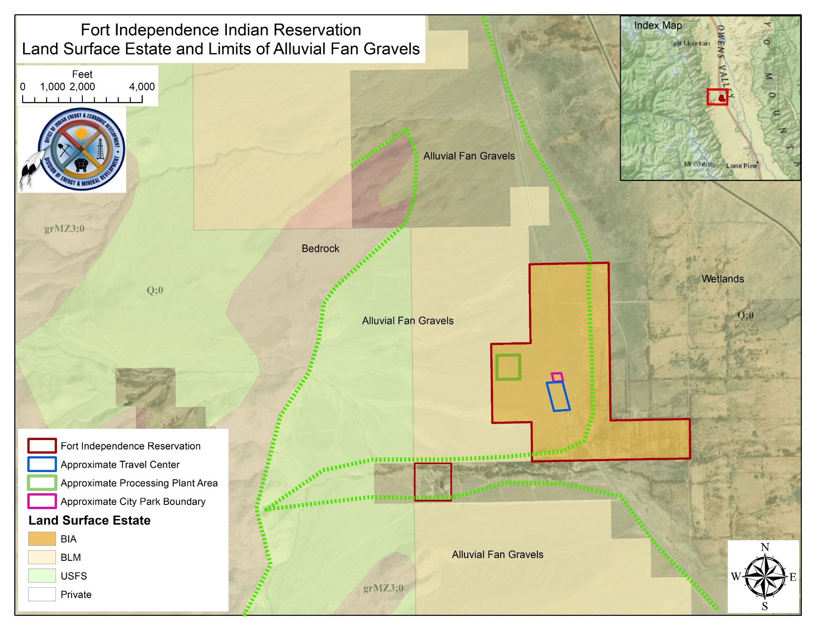
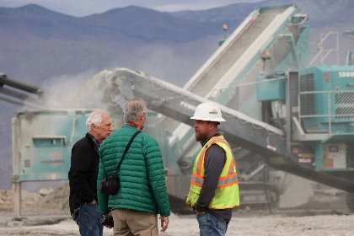
Fort Independence Indian Reservation, CA Aggregate Business
~ 600 acres along U.S. Highway 395
Substantial high quality aggregate resource
Tribe requested DEMD technical assistance to start an aggregate business
Tribe has four current projects that will yield approximately 1.1 Million tons of aggregate
Tribe pursuing land purchase opportunities
Tribe pursuing secondary markets
Tribe needs to determine future long-term aggregate resource - EMDP grant
Notes:
Red outline-Reservation; Green-BOR reservoir or processing plant???; Blue-Travel Center

Slide 32
Development Planning Team Members
Tribal Executives – Ft Independence Paiute Tribe
Construction Manager – Ft Independence Contractor
Product Marketing Specialist - Ft Independence Contractor
Team Manager - DEMD
Mining Engineer – DEMD
Solid Minerals Geologist – DEMD
Economics & Business Management Specialist (MBA) - DEMD
Finance & Business Architecture Specialist (MBA) - DEMD
Business Marketing & Branding Team – DEMD
Loan Guarantee Program – Division of Capital Investment (DCI)
Notes:
A true partnership between the Tribe and DEMD

Slide 33
Services Provided to the Tribe
Project Structuring – DEMD
Basic Geologic Assessment - DEMD
Volume/Year - DEMD
Plant Design - DEMD
Capex/Opex - DEMD
Cash Flow Analysis - DEMD
Internal/External Market Analysis - DEMD
Business Plan – DEMD
Sales Contracts - DEMD
Land Acquisition Planning and Assistance - DEMD
Mine Life Estimate – Tribe applied for EMDP grant – DEMD
Branding/Production of Marketing Material - DEMD
Indian Loan Guarantee Program Requirements – Division of Capital Investment (DCI)
Notes:
Two areas completed here in detail:
1) Resource Assessment and
2) all things necessary to get bank financing

Slide 34
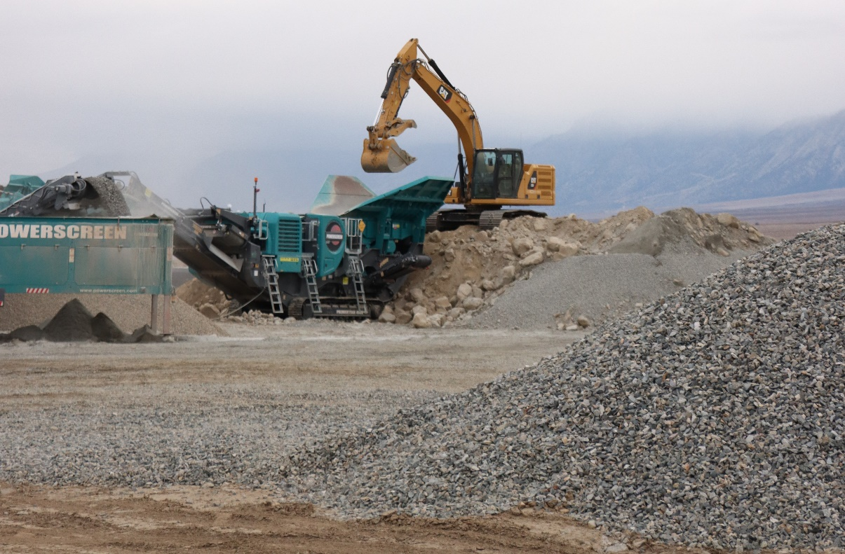
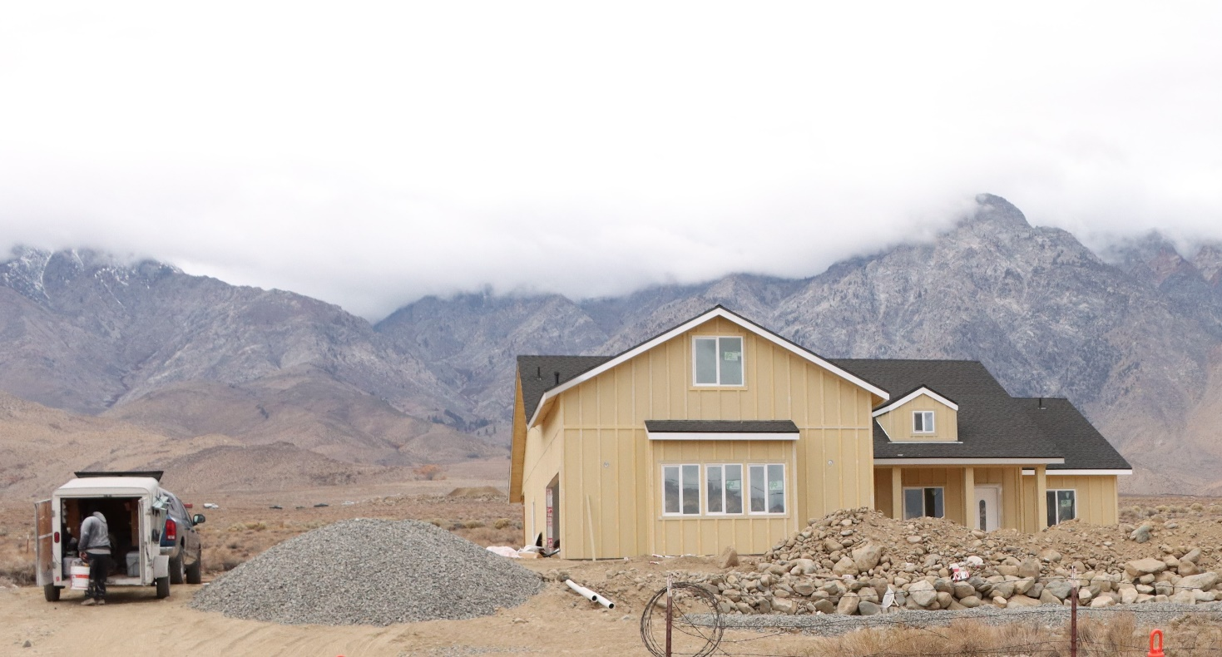
Notes:
Photos of plant in operation showing different aggregate products, and Tribal housing project showing tribal aggregate from this plant.

Slide 35
Grinding Rock Aggregates Website (https://grinding rocks.com )

Slide 36
Fort Independence Paiute Chairman’s Comments Closing Remarks about DEMD, at the conclusion of the First Development Team Meeting
“I feel like we have a dream team working together with us”
- Chairman Carl Dahlberg
Fort Independence Paiute Tribe
Notes:
Closing statements after the first full team meeting with the Tribe. Chairman Carl Dahlberg closed with this statement

Slide 37
CONTACT
Dennis Bodenchuk Roman/slavic Deputy Division Chief (Acting)
Branch Chief Solid Minerals (720) 407-0603 Dennis.Bodenchuk@bia.gov www.bia.gov/DEMD

Slide 38
Questions?

